Slide 1
FIFA 2022 PLAYERS
-By Shivam Mishra

Slide 2
Introduction
FIFA 2022 Players Data Set is a comprehensive dataset containing information about football players participating in FIFA 2022.
Goal: Extract meaningful insights using Unsupervised Machine Learning (UML) techniques.
UML: A category of algorithms that learn patterns from data without explicit supervision.

Slide 3
Objectives
Identify player clusters based on skill sets and attributes.
Discover hidden patterns within the dataset.
Reduce dimensionality for visualization and analysis.

Slide 4
Data Set Overview
Features:
Player Name
Age
Nationality
Overall Rating
Position
Skills, etc.
Size: 19239 x110
Source: Kaggle

Slide 5
Methodology
Data Collection
Data Preprocessing
EDA And Visualization
Result
PCA, KMeans And Hierarchical Clustering
Scaling Data

Slide 6
Unsupervised Machine Learning
Clustering
K-Means Clustering:
Divides players into k clusters based on similarities.
Optimal k determination using methods like the elbow method.
Dimensionality Reduction
Principal Component Analysis (PCA):
Reduces the number of dimensions while preserving as much variance as possible.
Visualizing players in a lower-dimensional space.

Slide 7
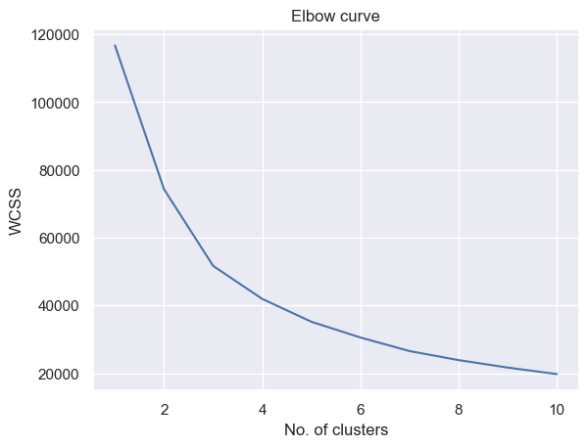
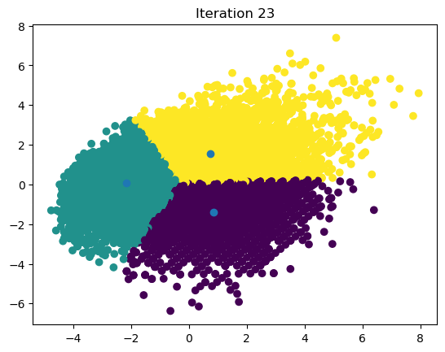
Results and Insights
Cluster Analysis:
Grouping of players based on skills and attributes.
Insights into player archetypes.
Dimensionality Reduction:
Visualization of players in reduced-dimensional space.
Identification of patterns and outliers.

Slide 8
Conclusion
In KMeans Algorithm I got the Silhouette score is 0.33064 and the Calinski – Harabasz Index is 11399.3581 and the Davies Bouldin Index Is 0.9890. In Hierarchical Clustering I got the Silhouette score is 0.3382 and the Calinski – Harabasz Index is 10193.8464 and the Davies Bouldin Index Is 1.1793.
We saw that the scores gives us moderate results which says that quality and similarities between the clusters holds but is not excellent.
KMeans is better than the Hierarchical Clustering for this model.

Slide 9
Thank You !!!

